Slide 1
COMPETITION TASK
Shreya Raina

Slide 2
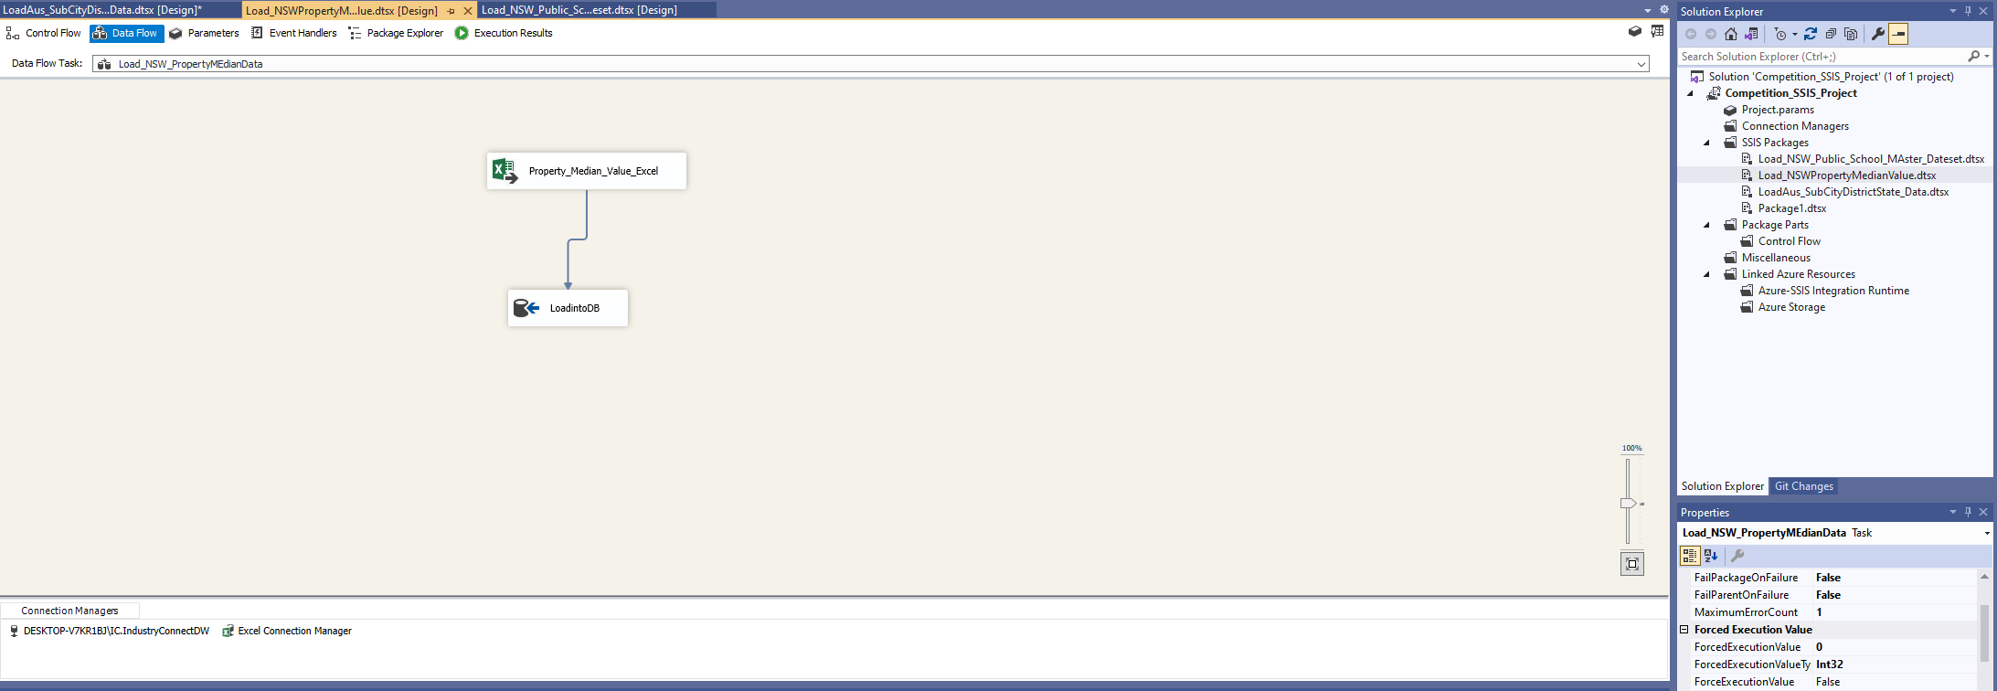

TASK:Use Visual Studio and create SSIS package, design dataflows to extract data from AUS_SubCityDistrictState_Data, NSW_PropertyMedainValue and NSW-Public-Schools-Master-Dataset (csv), and load data into tables into your Data Warehouse, use “load_” as prefix to name all your data load tables in your Data Warehouse
SSIS Packages created, designed dataflows to extract the data from excels.

Slide 3
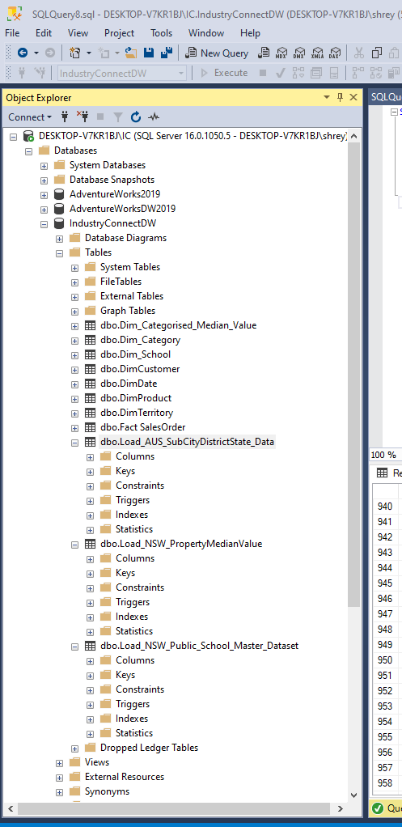

Data loaded into tables into the Datawarehouse.

Slide 4
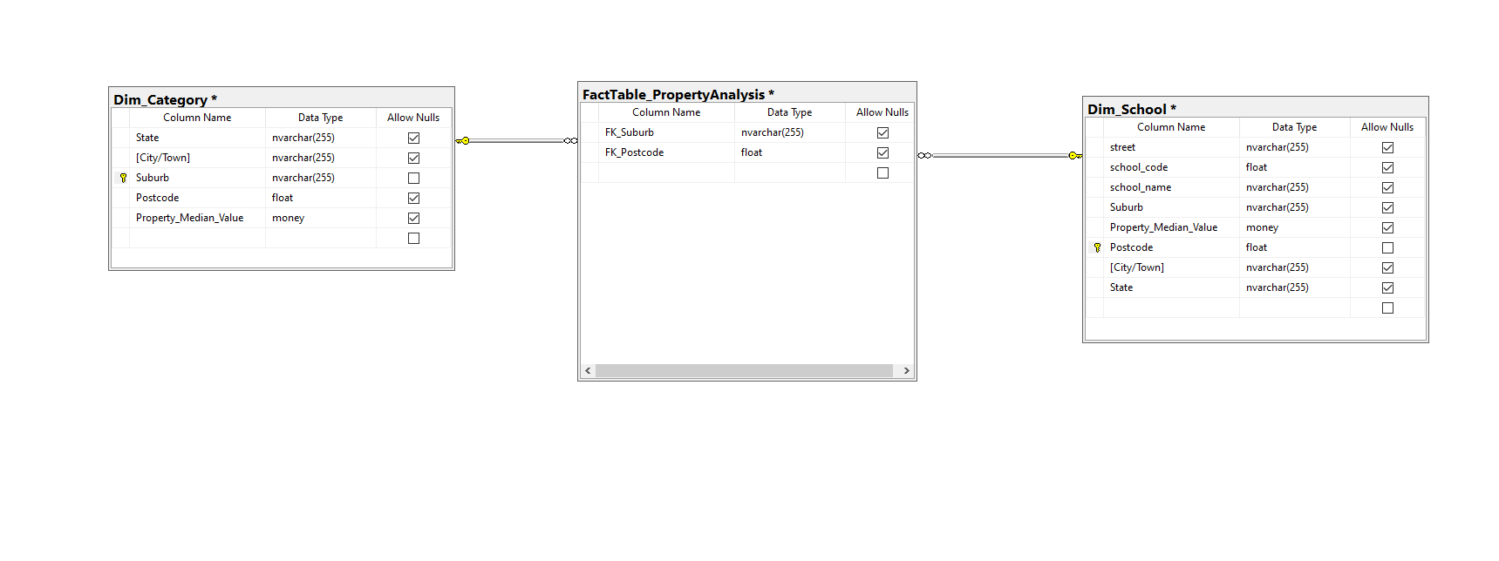
Star Schema Model

Slide 5
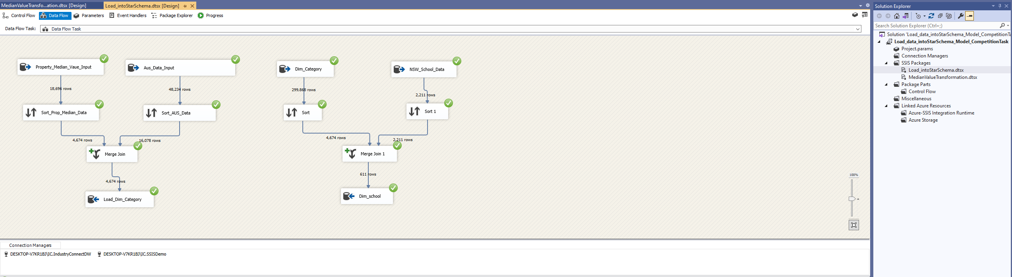
Task Create another SSIS package and design dataflows to get Data extracted from load tables, then transformed and loaded into Snowflake Schema Model or Star Schema Model.

Slide 6
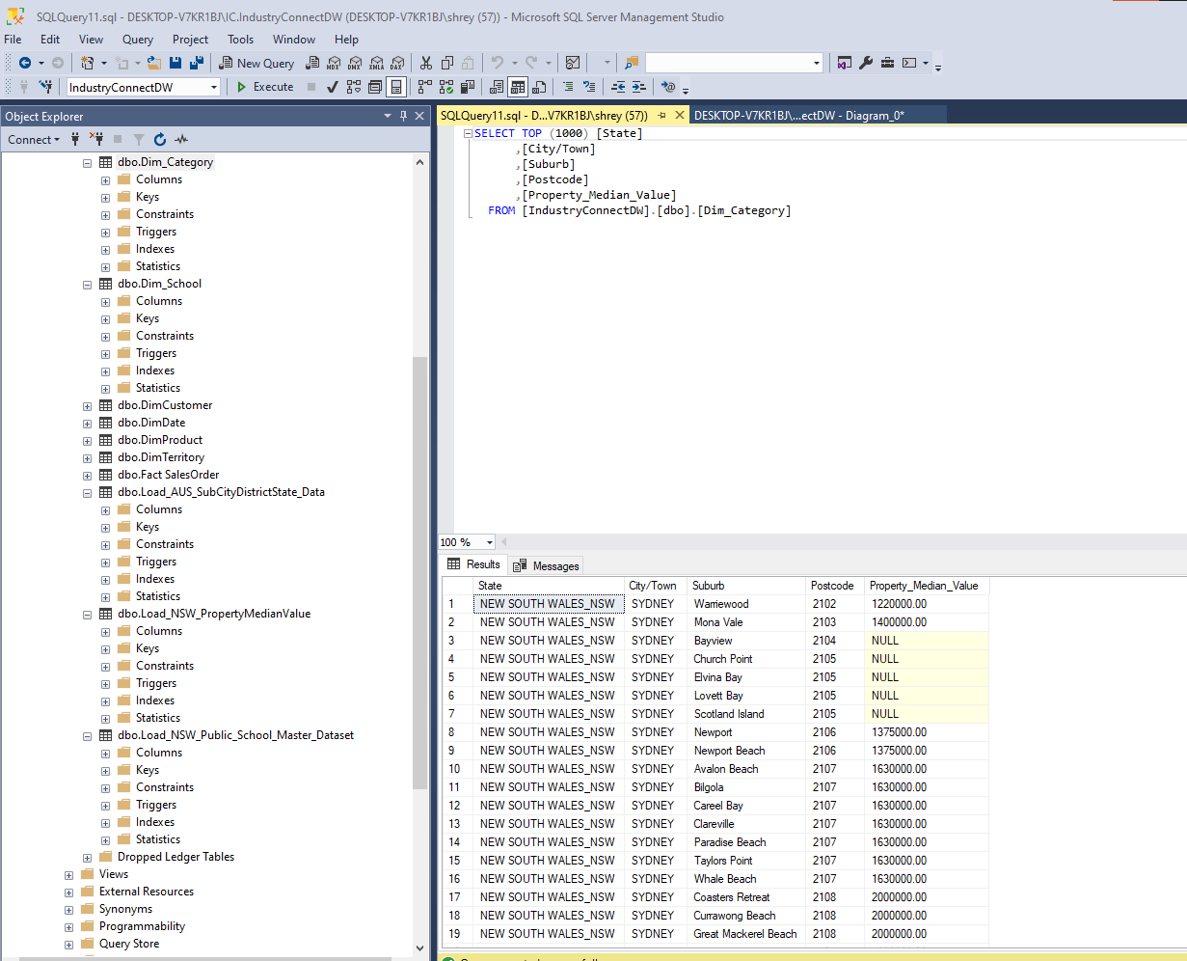
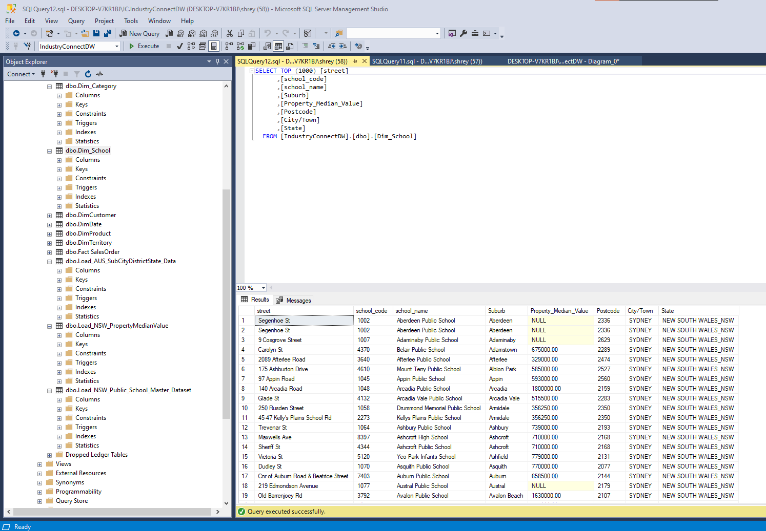


Loading the transformed data into the data warehouse tables

Slide 7
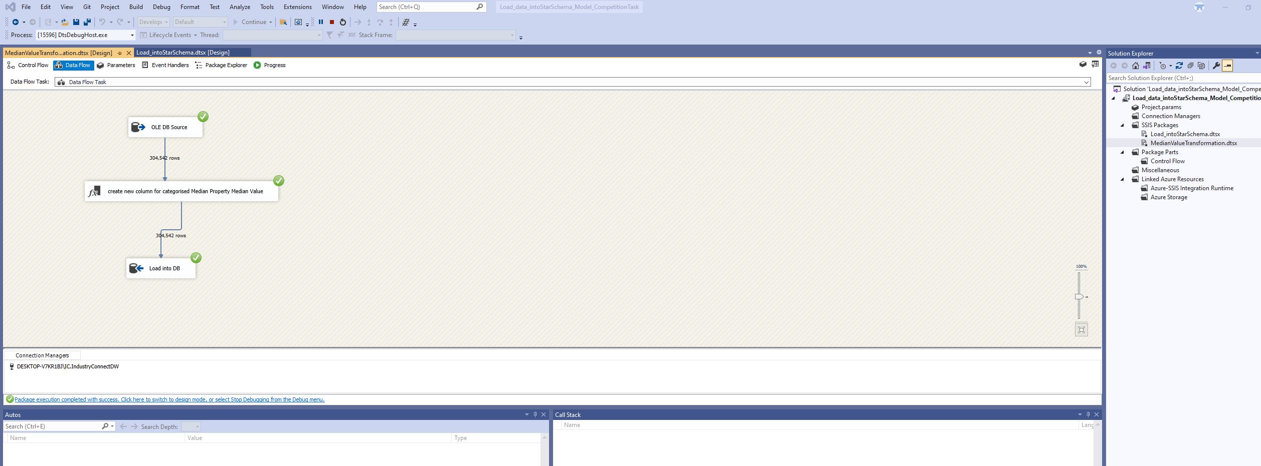
TASK: You need a “Category” as a dimension table ( or degenerate dimension in fact table), in SSIS categorize Median Value into Category 0-750k, $750k-$1.5M, $1.5M-$2.5M, $2.5M+ and load the “Category” values into dimension table (or degenerate dimension in fact table) , this is a transformation of business requirements for Property Analysis.

Slide 8
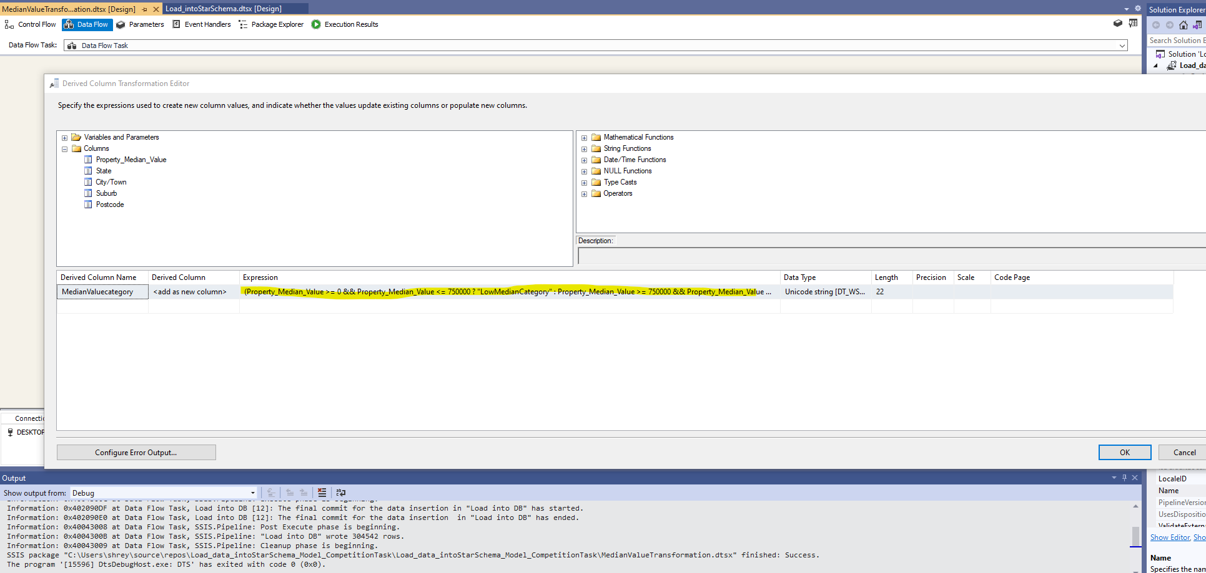
Transformation for creating a new column with categorised median value. If Property_Median_Value is between 0 – 750K than categorised as LowMedianValue. If Property_Median_Value is between 750K – 1.5M than categorised as MediumMedianValue. If Property_Median_Value is between 1.5M-2.5M than categorised as HighMedianValue. If Property_Median_Value is higher 2.5M than categorised as VeryHighMedianValue.

Slide 9
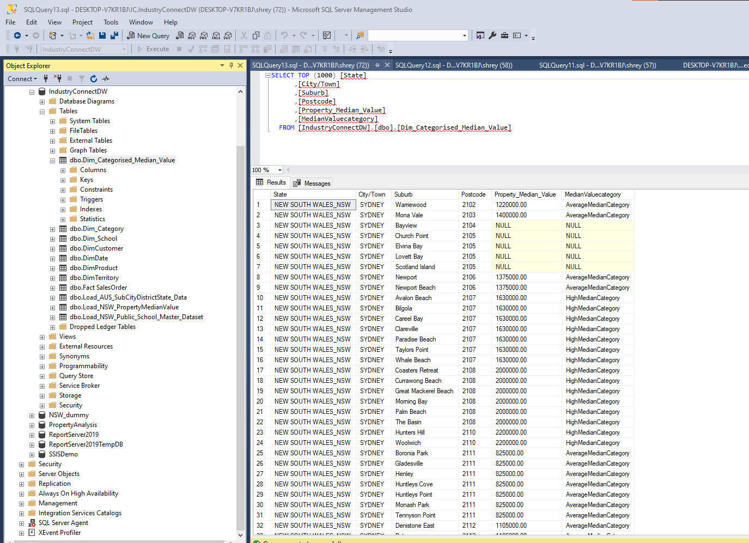

Loading category values after transformation.

